Slide 1

Team 5
Project Midterm Progress Report
Ruoning Ren/Huangshuai Shi/Jiahui Xi
05/17/2022

Slide 2
Progress Overview
What we did
Adapted HW codes for the card spring simulation project
Implemented the DEB (discrete elastic beam) and DER (discrete elastic rod) method
Completed simulation of Flex-and-Release motion

Slide 3
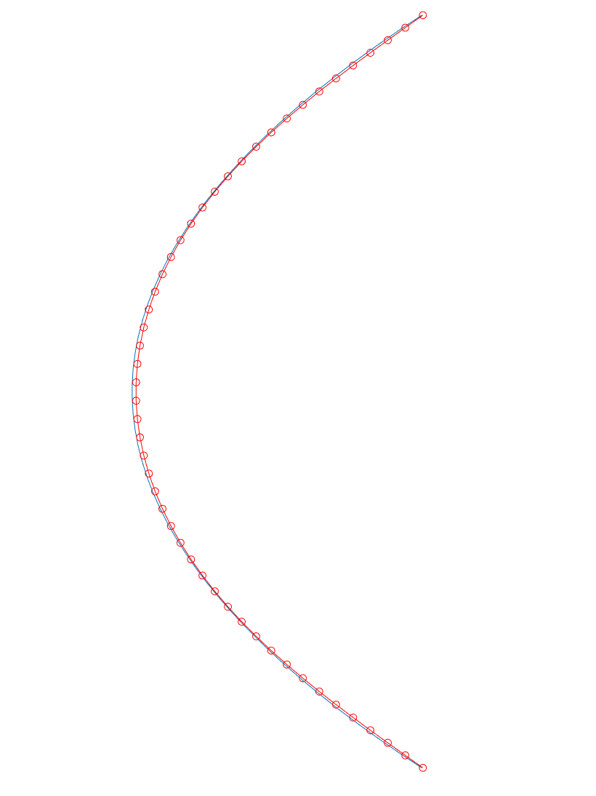
Simulation Approaches
DEB - Discrete Elastic Beam
Assumptions:
Uniform distribution of mass
Uniform distribution of bending force on the top and bottom edges of the card
Force components are parallel to x-axis and y-axis, no z-axis component

Slide 4
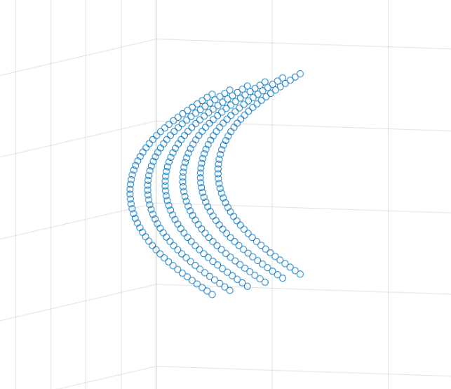
Simulation Approaches
DER - Discrete Elastic Rod
Assumptions:
Force can contain z-component
Under current conditions, the z-component maybe negligible

Slide 5
Phases of simulation
Phase I:
Bending the card until it reaches a designated equilibrium form
Top node fixed in the x and y directions
Bottom node fixed in the x direction

Slide 6
Phases of simulation
Phase II: without constraint
Releasing one bent card from phase I form (Card is able to oscillate and rebound)
All fixed nodes are released

Slide 7
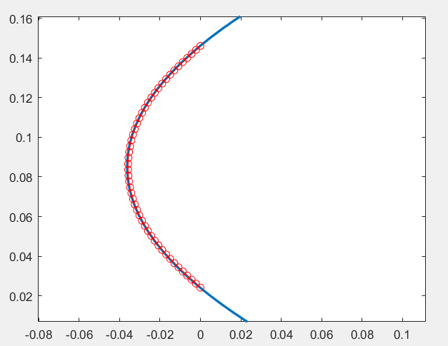
Phases of simulation
Phase II: with constraint
Card oscillates and rebounds against the card behind
Boundary is set -0.003m in x-direction in the same form as bent card
Shape of bent card is approximated by fitting a 2nd degree polynomial

Slide 8
Phases of simulation
Phase III:
Free oscillation and motion
after leaving from boundary contact
No contact force
No fixed nodes

Slide 9
Methods
Newton Raphson
Implement the Newton Raphson iterative method learned from class
Mass Modification
Incorporate Mass Modification in constraint and contact force definition

Slide 10
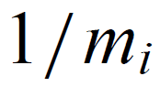
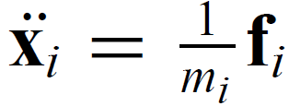
Mass Modification
Take the inverse of the original mass matrix such that the elements on the diagonal will become
The acceleration of node i will become

Slide 11
Mass Modification
When imposing a constraint in the i-th node, the mass matrix is modified in the i-th term on the diagonal. Each term on the diagonal has size of 2x2 corresponding to the x-component and the y-component (DEB approach)
To add constraint in a certain axis, make the corresponding component to zero.
Thus, only the accelerations on unconstrained nodes/their unconstrained axes are considered.

Slide 12
Mass Modification
When the constraint has components on both x and y axes, for example, when a node is restricted of accelerating along P (a unit vector with x and y components), the inverse mass matrix becomes 1/m_{i}(I - P_{i}P_{i}^{T})
When obtaining the Δv_{i} consistent with the constraint, a velocity component z_{i} along the constraint P will be imposed to balance the equation of motion constituted by Newton’s 2nd law.

Slide 13
Further Improvements
Phase II coding optimization
Viscous damping needs to be incorporated into simulation of
Phase III
Include rendered animation
Create simulation based on DEP (Discrete Elastic Plates)

Slide 14
References
[1] Baraff, David, and Andrew Witkin. "Large steps in cloth simulation." In Proceedings of the 25th annual conference on Computer graphics and interactive techniques, pp. 43-54. 1998.
[2] Bergou, M., Wardetzky, M., Robinson, S., Audoly, B., and Grinspun, E. Discrete elastic rods. In ACM SIG GRAPH 2008 Papers (2008), SIGGRAPH ’08, pp. 63:1–63:12.

